Slide 1
IOTA Power Supply Support
Jimmy You
Aug. 12, 2021
URL: IOTA_BiRA_Power_Supplier_Support

Slide 2
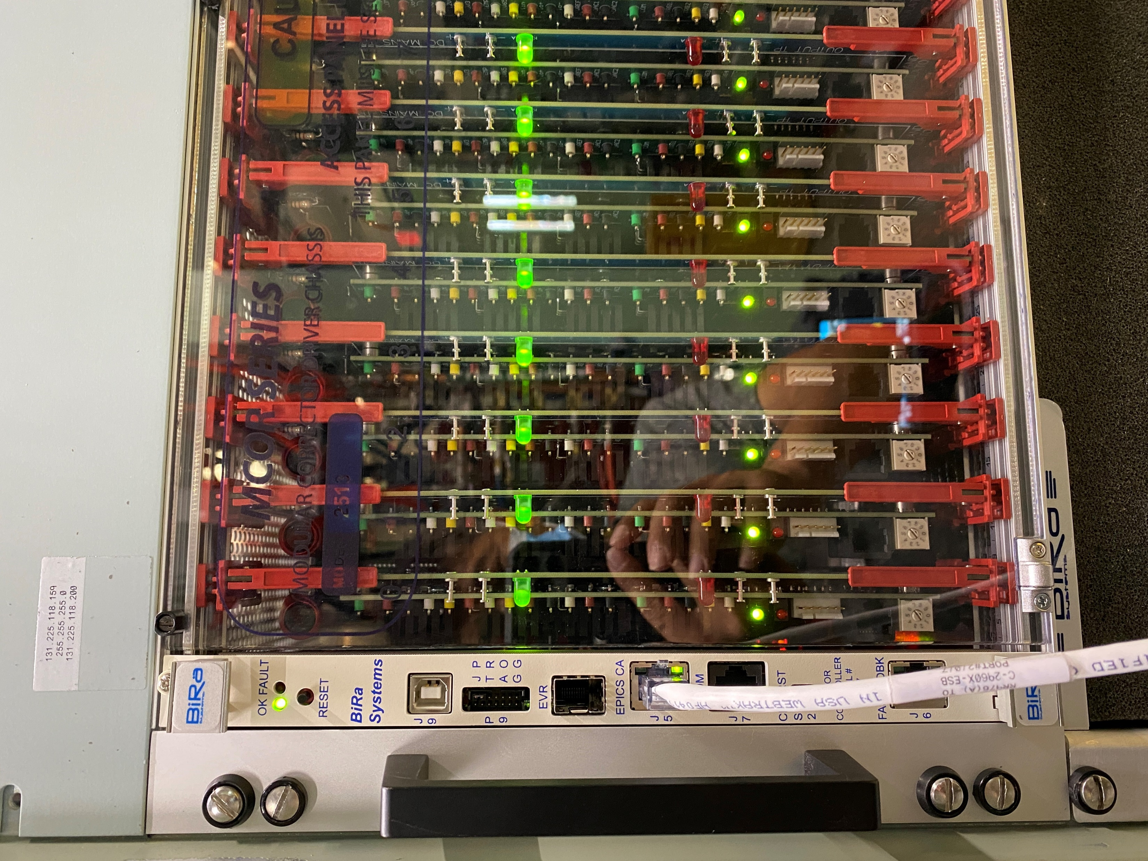
Hardware
https://www.bira.com/mcor-crate-datasheet.html
Ethernet MCOR (EMCOR) Controller Module
Ametek DC Power Supplies
TDK-Lambda GEN30-25 supplies
PCRC(Precision Current Regulator Controller)-7272

Slide 3
PXE boot process
dhcpd.conf at clxsrv (snippet from Jim)
# BiRa-EMCOR EPICS IOC's: FAST/IOTA Jimmy You and Kermit Carlson group { # BiRA-EMCOR next-server clxsrv; # TFTP server if exists user-class and option user-class = "iPXE" { filename "linuxRT/boot/ipxe.ini"; } elsif option client-architecture = 00:00 { filename "linuxRT/boot/undionly.kpxe"; } else { filename "ipxe.efi"; } host bira-emcor-2517-osc-1.fnal.gov { hardware ethernet 00:07:32:4E:41:FA;
fixed-address 131.225.118.159; } } # End BiRa-EMCOR group
Client broadcasts DHCPDISCOVER.
DHCP server responds with IP address, next-server, filename,
Client sends TFTP request to next-server asking to retrieve filename.
TFTP server responds and sends filename to client.
Client executes filename and loads the kernel.
And execute /usr/local/epics/iocCommon/{host}/startup.sh (/usr/local/epics/youj/rios 0000:01:00.0@0)

Slide 4
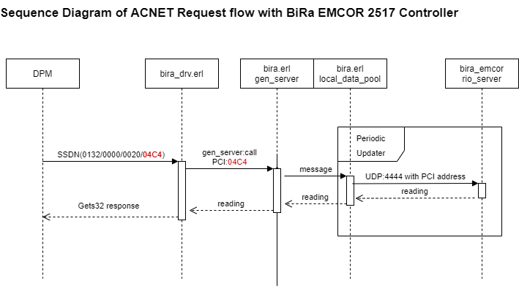
Software

Slide 5
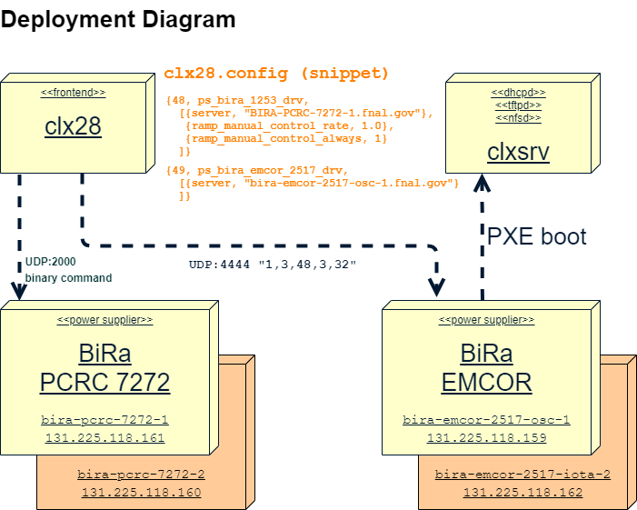
Deployment

Slide 6
Operation/Monitor/Troubleshooting
ssh root@bira-emcor-2517-osc-1 to access the shell
(public-key authentication is required. Must register at clxsrv by Jim)
Monitor parameter page: H55/16
Standard Erlang frontend running on clx28
BiRa EMCOR 2517 controller listens to UDP on port 4444
BiRa PCRC 7272 controller listens to UDP on port 2000
Source code at GIT
BiRa EMCOR 2517 user manual
BiRa PCRC 7272 user manual

